Slide 1



Better Audit Institutions for Better Impact of Public Services
PROINTER
7th October 2025

Slide 2
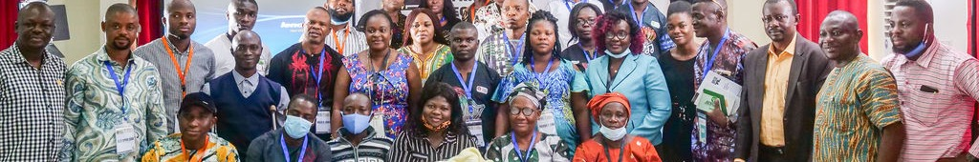

The Foundation of Change
Public institutions play a foundational role in protecting and materializing rights and ensuring fairness across societies.
Yet institutions are made of regulations and people that reflect gendered societies and reproduce inertias, creating barriers to true equality.
Notes:
DIMINUIÇÃO MARCADA NA CONFIANÇA INSTITUCIONAL:
A % de pessoas que confiam nas suas instituições diminuiu de 46% em 2009 para 36% em 2021.
E no relativo a instituições financeiras, diminuiu de 55% a 46% dm 2021.
Fonte: UNDESSA, 2021.

Slide 3
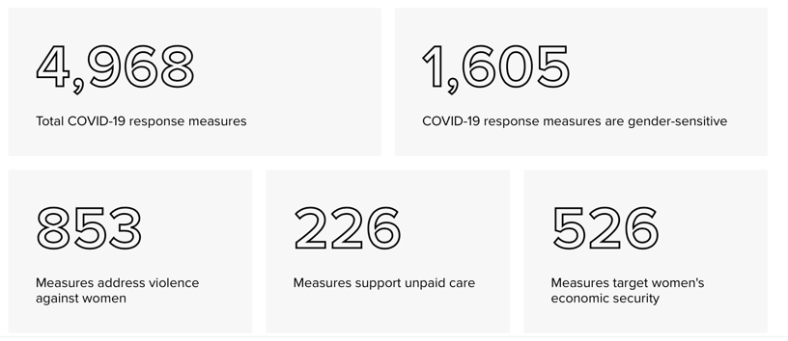
Public policies fail to address women's needs and gender inequalities
Only 1 in 3 COVID-19 policy measures taken globally addressed gender equality issues.
Notes:
DIMINUIÇÃO MARCADA NA CONFIANÇA INSTITUCIONAL:
A % de pessoas que confiam nas suas instituições diminuiu de 46% em 2009 para 36% em 2021.
E no relativo a instituições financeiras, diminuiu de 55% a 46% dm 2021.
Fonte: UNDESSA, 2021.

Slide 4
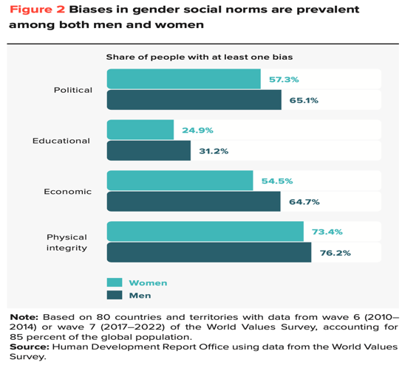
Gender inequality remains structurally embedded in institutional culture
90% of the world's population holds at least one gender bias against women.
Notes:
DIMINUIÇÃO MARCADA NA CONFIANÇA INSTITUCIONAL:
A % de pessoas que confiam nas suas instituições diminuiu de 46% em 2009 para 36% em 2021.
E no relativo a instituições financeiras, diminuiu de 55% a 46% dm 2021.
Fonte: UNDESSA, 2021.

Slide 5
UNDP’s proposal
Institutional Change is Key
Comprehensive Approaches
Are Needed
Institutional transformation is the foundation upon which all other gender equality efforts rest, ensuring commitments translate into sustained action.
Advancing gender equality and women’s empowerment requires working in different areas and levels while strengthening capacities and facilitating reforms.
The vision: Strong, skilled and effective public institutions that deliver for gender equality and sustainable development
Notes:
DIMINUIÇÃO MARCADA NA CONFIANÇA INSTITUCIONAL:
A % de pessoas que confiam nas suas instituições diminuiu de 46% em 2009 para 36% em 2021.
E no relativo a instituições financeiras, diminuiu de 55% a 46% dm 2021.
Fonte: UNDESSA, 2021.

Slide 6
A comprehensive approach is needed
Gender equality mechanisms
Interinstitutional coordination
Civil Society engagement
Political
Technical
Cultural
Leadership
Decision making
Resources
Understanding
Skills
Perceptions
Attitudes
Behaviours
Accelerate progress towards SDG 5 and 16 and sustainable development

Slide 7





UNDP's Comprehensive Solution
A comprehensive set of STANDARDS on gender equality to achieve institutional transformations in management practices.
A tailored ROADMAP with the steps to improve planning, implementing, monitoring and evaluating public policies and services.
A package of context-specific SERVICES and tools through which UNDP provides sustained support.
A GLOBAL CERTIFICATION and recognition granted by UNDP to public institutions that achieve gender equality global standards.

Slide 8








Participation, Partnerships & Accountability
Planning & Management for Gender Equality
The Gender Seal Standard
Interinstitutional coordination
Civil society engagement
Accountability to women’s movements
Respect and fair treatment for all citizens
Institutionalized objectives and mainstreaming mechanisms
Budget allocated and executed
Sex disaggregated database & gender monitoring systems
Women owned SMSs access to institutional procurement
Results & Impacts
of Public Policies
Enabling Work Environment
Architecture & Capacities
Dimensions
Standards
Work and life balance for all
Zero tolerance to SH and GBV and discrimination
Understanding salary gaps
Equal opportunities for professional development & gender parity in decision making
In house gender expertise
Gender equality architecture and staff equipped with tailored gender capacities
Senior leadership for gender equality
Gender responsive communication
Benchmarks
Results and impacts
Reduction of gender gaps
Gender responsive policies and services

Slide 9


Gender Equality Seal Steps
Award
Assess
Implement
Baseline
Engage
24
a journey towards excellence
3 years validity
months

Slide 10




Gold: 80% compliance
Silver: 70%
compliance
Bronze: 60%
compliance
Levels of Certification

Slide 11
UNDP Services
1. Engage
Help to set a Gender Steering Committee, access to the online platform, and ensure local gender advisory support.
2. Set the Baseline
Support a baseline self-assessment, capacity building and provide tools and knowledge.
Help to design and implement action plan for improvement, sector specific capacity building and advisory support, and engagement in a Community of Practice
3. Learn & Improve
4. External Assessment
Deploy an independent, high quality external evaluation with recommendations for further improvement
5. Certification
A globally recognized certification valid for 3 years

Slide 12

Seal Reach and Results

Slide 13
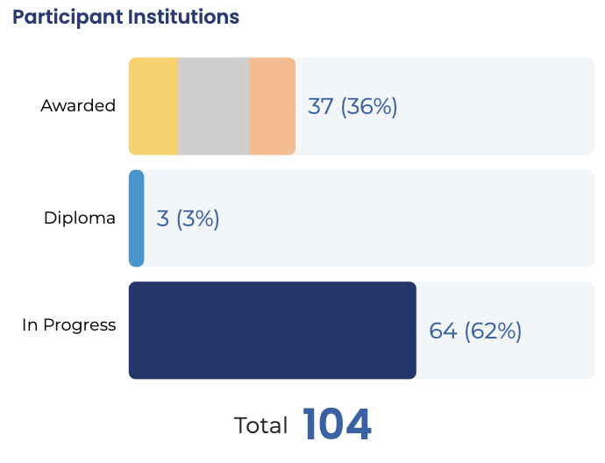
OUTREACH

Slide 14
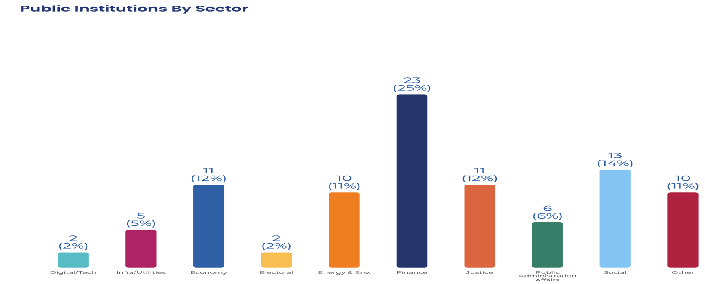
OUTREACH

Slide 15
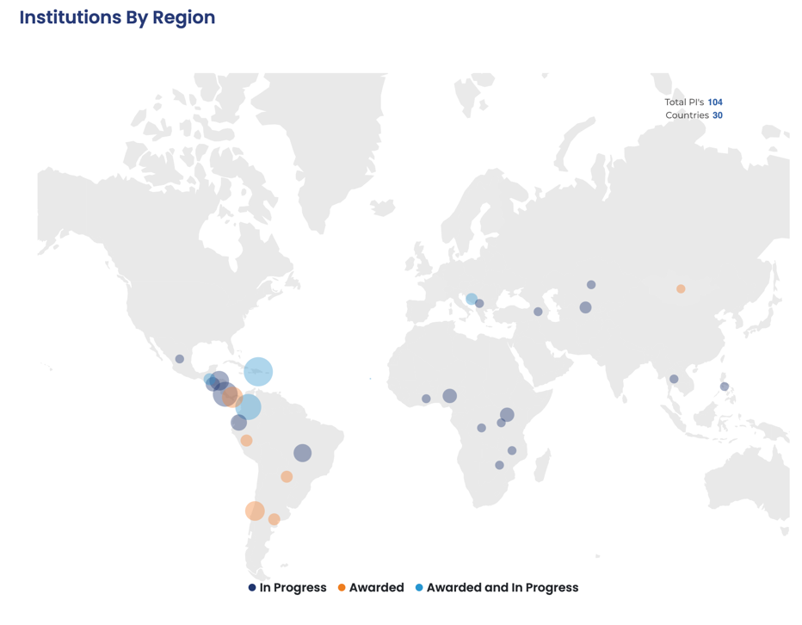
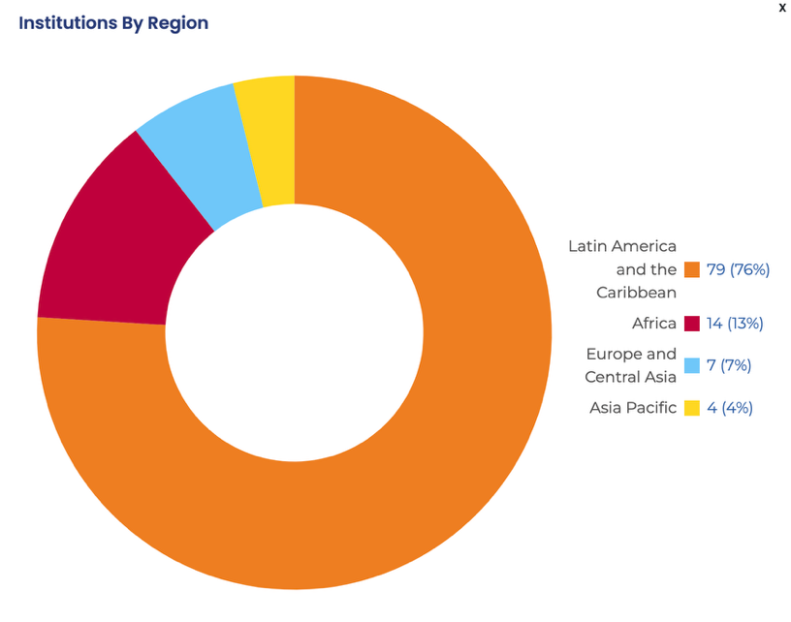
OUTREACH

Slide 16
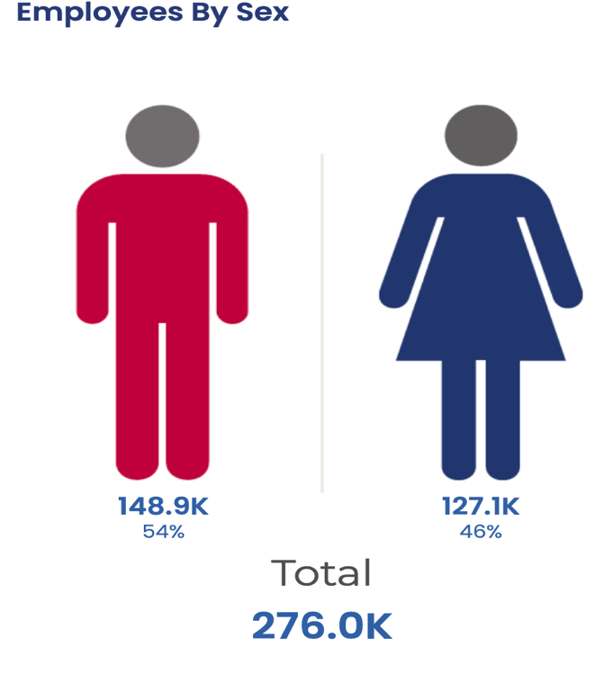
OUTREACH

Slide 17
IMPACT

Slide 18
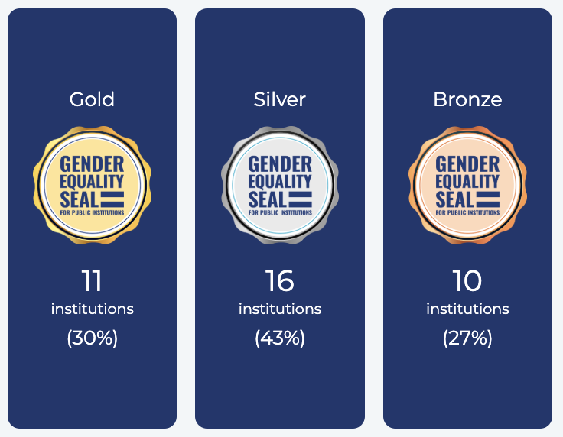
RESULTS

Slide 19
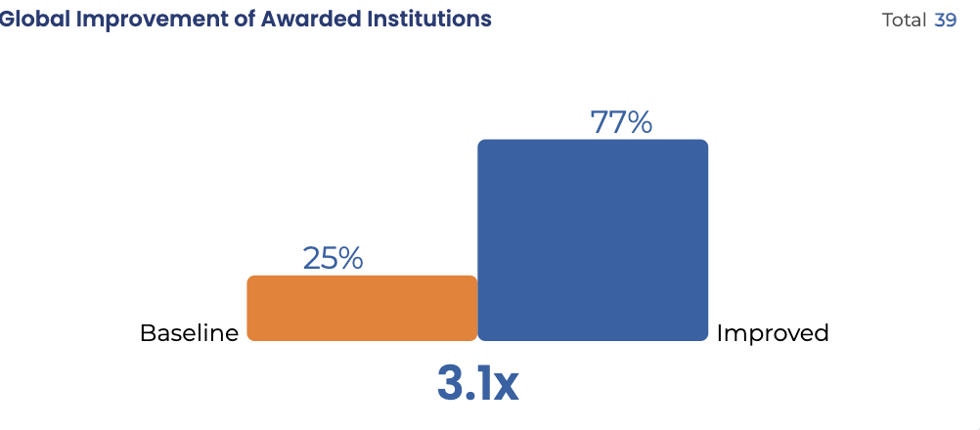
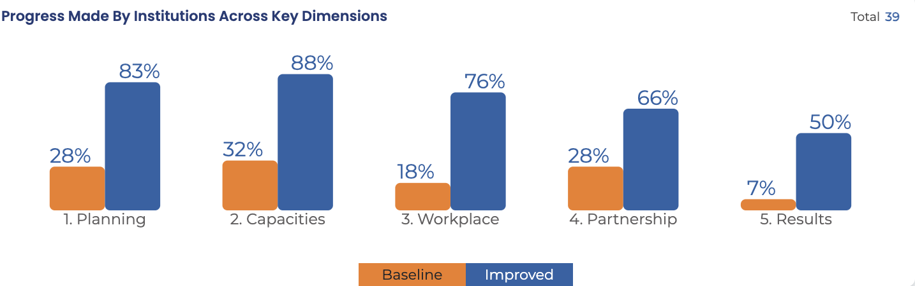
RESULTS

Slide 20
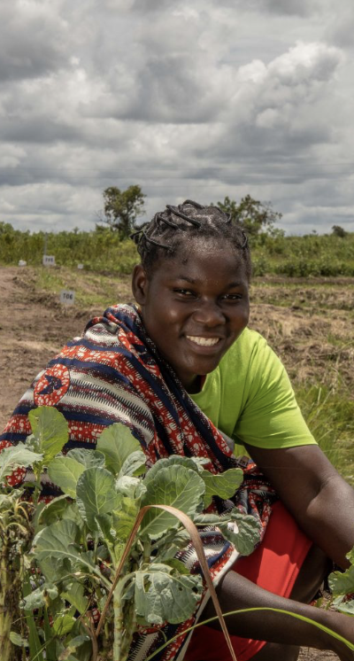
Across the 5 Dimensions:
83%
65%
have institutionalized explicit gender equality goals in strategic planning
have full time gender departments with action plans with budget in implementation, reporting to senior authorities
Results:
By the Numbers
40%
70%
show significant gender equality results in at least the two main institutional programs
65%
have institutional mechanisms in place to ensure systematic data disaggregation by sex
have achieved gender parity in decision-making positions
74%
100%
are engaging with civil society, women, and feminist organizations to discuss gender equality related policies & programs
have a zero tolerance GBV and Sexual Harassment workplace policy

Slide 21
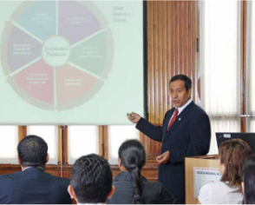

Results & Impacts
Internal:
Gender parity achieved in decision making positions.
Zero tolerance policy against sexual harassment policy and protocol strengthened.
Relevant provisions to improve work life balance for staff, including promoting men’s co-responsibility.
External:
CGR’s audits identified underperformance of the Women's Emergency Centers: inadequate environments for confidentiality, registration errors, and lack of follow-up on care plans and protection measures for victims.
Lead to an improvement plan for the National Program for the Prevention and Eradication of Violence Against Women, strengthening the services for women victims.
Comptroller General of the Republic
Peru
Notes:
Ministério da Justiça e Direitos Humanos, Província de Buenos Aires (MJDH), Argentina. O Ministério conseguiu a redução de 20% na reincidência de homens processados por violência de gênero por causa dos programas de masculinidades para agressores masculinos acompanhados pelo Patronato de Liberados Bonaerense (exclui autores de feminicídios ou homens condenados por tentativa de feminicídio). A aplicação da medida de prisão domiciliar para mães com filhos menores de 5 anos aumentou para 50%, e a participação de mulheres privadas de liberdade em estudos universitários aumentou em 70% nos últimos 4 anos. É importante ressaltar que conseguiu reverter a tendência masculinizante na carreira penitenciária, com a modificação dos regulamentos de admissão ao Serviço Prisional para erradicar preconceitos indiretos de gênero; paridade de gênero alcançada em graduados da Escola de Cadetes do Serviço Prisional, aumentando de 30% para 70% (2019-2023) as inscrições de mulheres no serviço penitenciário, e a primeira mulher promovida a diretora da escola. O Ministério e a Universidade Nacional de La Plata lançaram o curso de bacharelado em Gestão Penitenciária, cujo currículo inclui “Perspectiva de Gênero e Diversidade” como parte dos currículos.

Slide 22
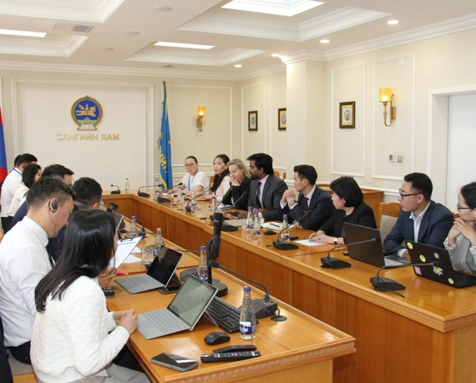

Results & Impacts
Internal systems
Sex and age disaggregated data system in place with KPIs to follow gender gaps.
Tax services gender checklist institutionalized and staff in the regions trained to implement it.
Improved services to tax payers:
Dedicated taxpayer education programs for women taxpayers and entrepreneurs.
Engagement with women’s CSOs to better address gender issues in tax compliance.
Tax policy reforms
Ministry of Finance assessment of indirect gender biases in personal income tax policies.
General Tax Authority
Mongolia
Notes:
Ministry of Justice and Human Rights, Buenos Aires Province (MJDH), Argentina. The Ministry achieved the reduction of 20% in the recidivism of men prosecuted for gender violence because of the masculinities programs for male aggressors accompanied by the Patronato de Liberados Bonaerense (exclude perpetrators of femicides or men convicted of attempted femicide). The application of the measure of house arrest for mothers with children under 5 years of age increased to 50%, and the participation of women deprived of liberty in university studies increased by 70% in the last 4 years. Importantly, it has managed to reverse the masculinizing trend in the penitentiary career, with the modification of the Prison Service admission regulations to eradicate indirect gender biases; gender parity achieved in graduates from the Cadet School of the Prison Service, increasing from 30% to 70% (2019-2023) women applications to the penitentiary service, and the first ever woman promoted as director of the school. The Ministry and the National University of La Plata launched the bachelor’s degree in Prison Management, whose curriculum includes “Gender and Diversity Perspective” as part of the curricula.

Slide 23

Advances
Audit on Systems and Practices for the Prevention and Combat of Harassment in Federal Universities
Audit on SDG 5.5
Citizen Task Force - Schools Construction Works: Data collection regarding the influence of daycare availability on women's lives to bolster the communication campaign of the Task Force Works.
Tribunal du Contas
Brazil
In the making…
Notes:
Ministry of Justice and Human Rights, Buenos Aires Province (MJDH), Argentina. The Ministry achieved the reduction of 20% in the recidivism of men prosecuted for gender violence because of the masculinities programs for male aggressors accompanied by the Patronato de Liberados Bonaerense (exclude perpetrators of femicides or men convicted of attempted femicide). The application of the measure of house arrest for mothers with children under 5 years of age increased to 50%, and the participation of women deprived of liberty in university studies increased by 70% in the last 4 years. Importantly, it has managed to reverse the masculinizing trend in the penitentiary career, with the modification of the Prison Service admission regulations to eradicate indirect gender biases; gender parity achieved in graduates from the Cadet School of the Prison Service, increasing from 30% to 70% (2019-2023) women applications to the penitentiary service, and the first ever woman promoted as director of the school. The Ministry and the National University of La Plata launched the bachelor’s degree in Prison Management, whose curriculum includes “Gender and Diversity Perspective” as part of the curricula.

Slide 24
Why the Seal for Audit institutions?

Slide 25





What the Seal for Audit institutions?
The Seal represents a transformative opportunity for Supreme Audit Institutions to elevate their impact, credibility, and relevance.
Improve Audit Quality and Relevance
Align with Global Standards
More inclusive and comprehensive audits that reflect the realities of all population groups, ensuring no one is left behind in public accountability.
Supports compliance with international frameworks (SDGs, CEDAW and Beijing Platform) demonstrating commitment to universal principles of equality.
Foster Innovation in Oversight
Build Institutional Capacity
Tools, training and benchmarks to strengthen internal systems and staff competencies on gender equality, creating sustainable organizational improvement.
Encourages SAIs to develop new methodologies and approaches for gender-responsive auditing and evaluation, positioning institutions at the forefront of public sector innovation.

Slide 26




What the Seal for Audit institutions?
Strengthen Institutional Credibility
and Public Sector Accountability
Boost Staff Engagement
Enhance trust and legitimacy among citizens and stakeholders while building confidence in audit findings.
Cultivates a workplace culture that values diversity, inclusion, and equal opportunity for all employees, leading to higher satisfaction and retention rates.
Gain International Recognition
Access Global Community of Practice
Position SAIs as leaders in public sector transformation and showcases commitment to progressive governance practices.
Connects SAIs with peers worldwide to share experiences, tools, and lessons learned, creating opportunities for continuous learning and collaboration.

Slide 27

The Gender Equality Seal serves is an important tool, enabling addressing gender equality issues within public institutions in a more focused way.
We are grateful to the Seal for helping us to showcase the enormous commitment from all areas to create a Bank that works for gender equality.
The Gender Equality Seal has allowed the gender perspective to be positioned within institutional priorities.
Nikol Pashinyan
Prime Minister
Republic of Armenia, 2024
Silvina Batakis
President
Bank of the Argentinian Nation, 2023
Oscar Estuardo Cossío Cámara
President
CONRED Guatemala, 2023
The Seal has really helped us as FIRS to understand and appreciate the nexus between gender equality and taxation.
The Seal is clear, rational, and has a methodology that is in accordance with our national laws and policies.
Angel Fadahunsi
Director, Career Development
Federal Inland Revenue Service Nigeria, 2024
Zayabal B.
Head of the General Department of Taxation of Mongolia, 2023

Slide 28

Thank You!
www.gendersealpublicinstitutions.org
ana.landa@undp.org

