Slide 1

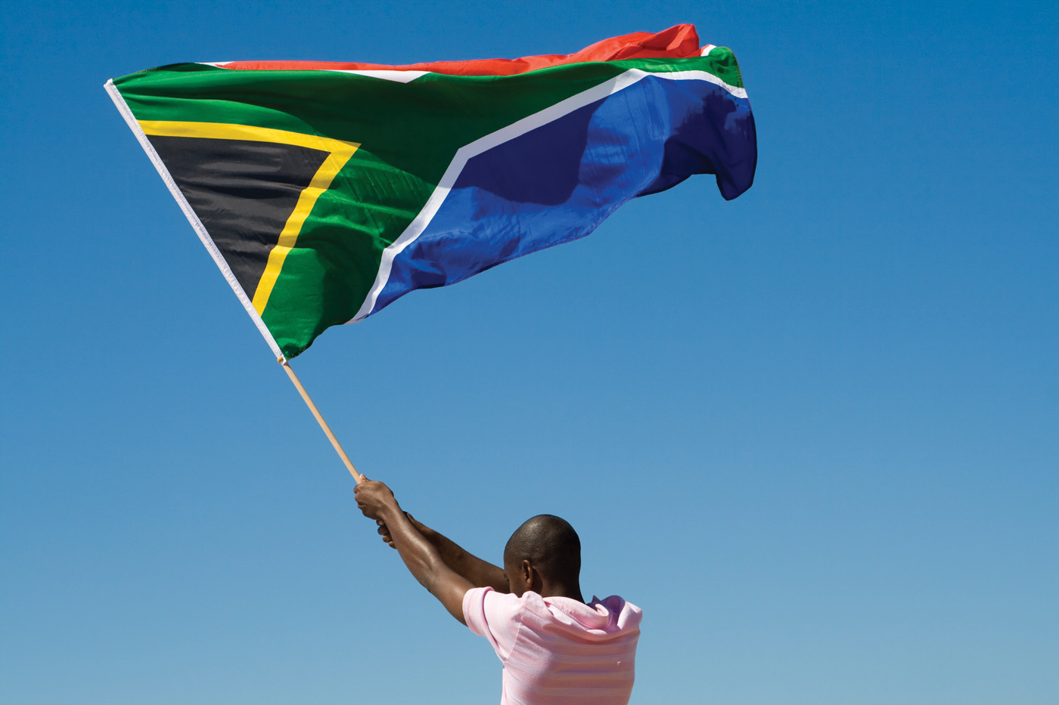

Experience with the AFROSAI Women Leadership Academy

Slide 2





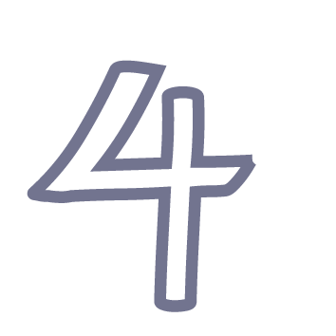


Overview
Why do SAIs exist?
Key learnings on the WLA programme
Finding My Voice
Watering her voice so she can have results
Way forward

Slide 3
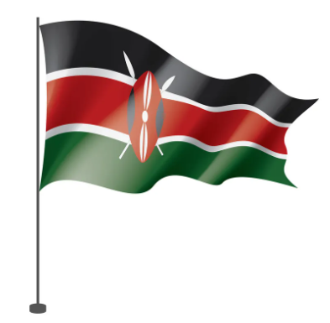

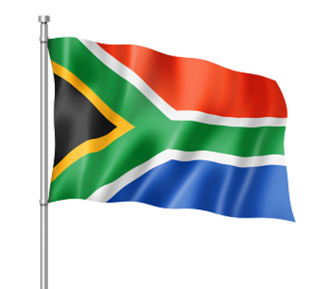

Guardians of Public Accountability
“SAIs across Africa share a common purpose: enhancing accountability, transparency, and good governance in the public sector. While each SAI may express its vision or mission differently, the underlying mandate is the same — and that is what unites us in purpose.
Mandate: Audit and report on the use of public resources by all entities funded by public funds (per Constitution, Art. 229).
SAI Kenya
Mission: To provide timely quality audit services to promote transparency and accountability in managing public resources.
SAI Zambia
SAI South Africa
Vision: To be recognised as a relevant SAI that enhances public sector accountability. Mission: To strengthen democracy by enabling oversight, accountability and governance through auditing, thereby building public confidence.
SAI Cameroon
Mission: To audit and oversee public finances, promote transparency, sanction mismanagement, and prevent corruption in public institutions.

Slide 4

Key learnings on the WLA programme
Key Learnings – Gender Inclusivity
Understanding gender dynamics in institutions
The importance of creating inclusive environments
Amplifying women’s voices in spaces where they are underrepresented
Shifting SAIs toward more balanced leadership
Key Learnings – Gender Roles
How societal expectations shape women’s aspirations
Challenging traditional stereotypes in leadership
Embracing diversity in roles and contributions
Redefining success for women leaders
Key Learnings – Leadership & Strategic Planning
Leading with vision and clarity
Thinking beyond technical expertise toward institutional impact
Building strategies that are inclusive, practical, and forward-looking
Aligning leadership to SAI mandates and citizen expectations

Slide 5
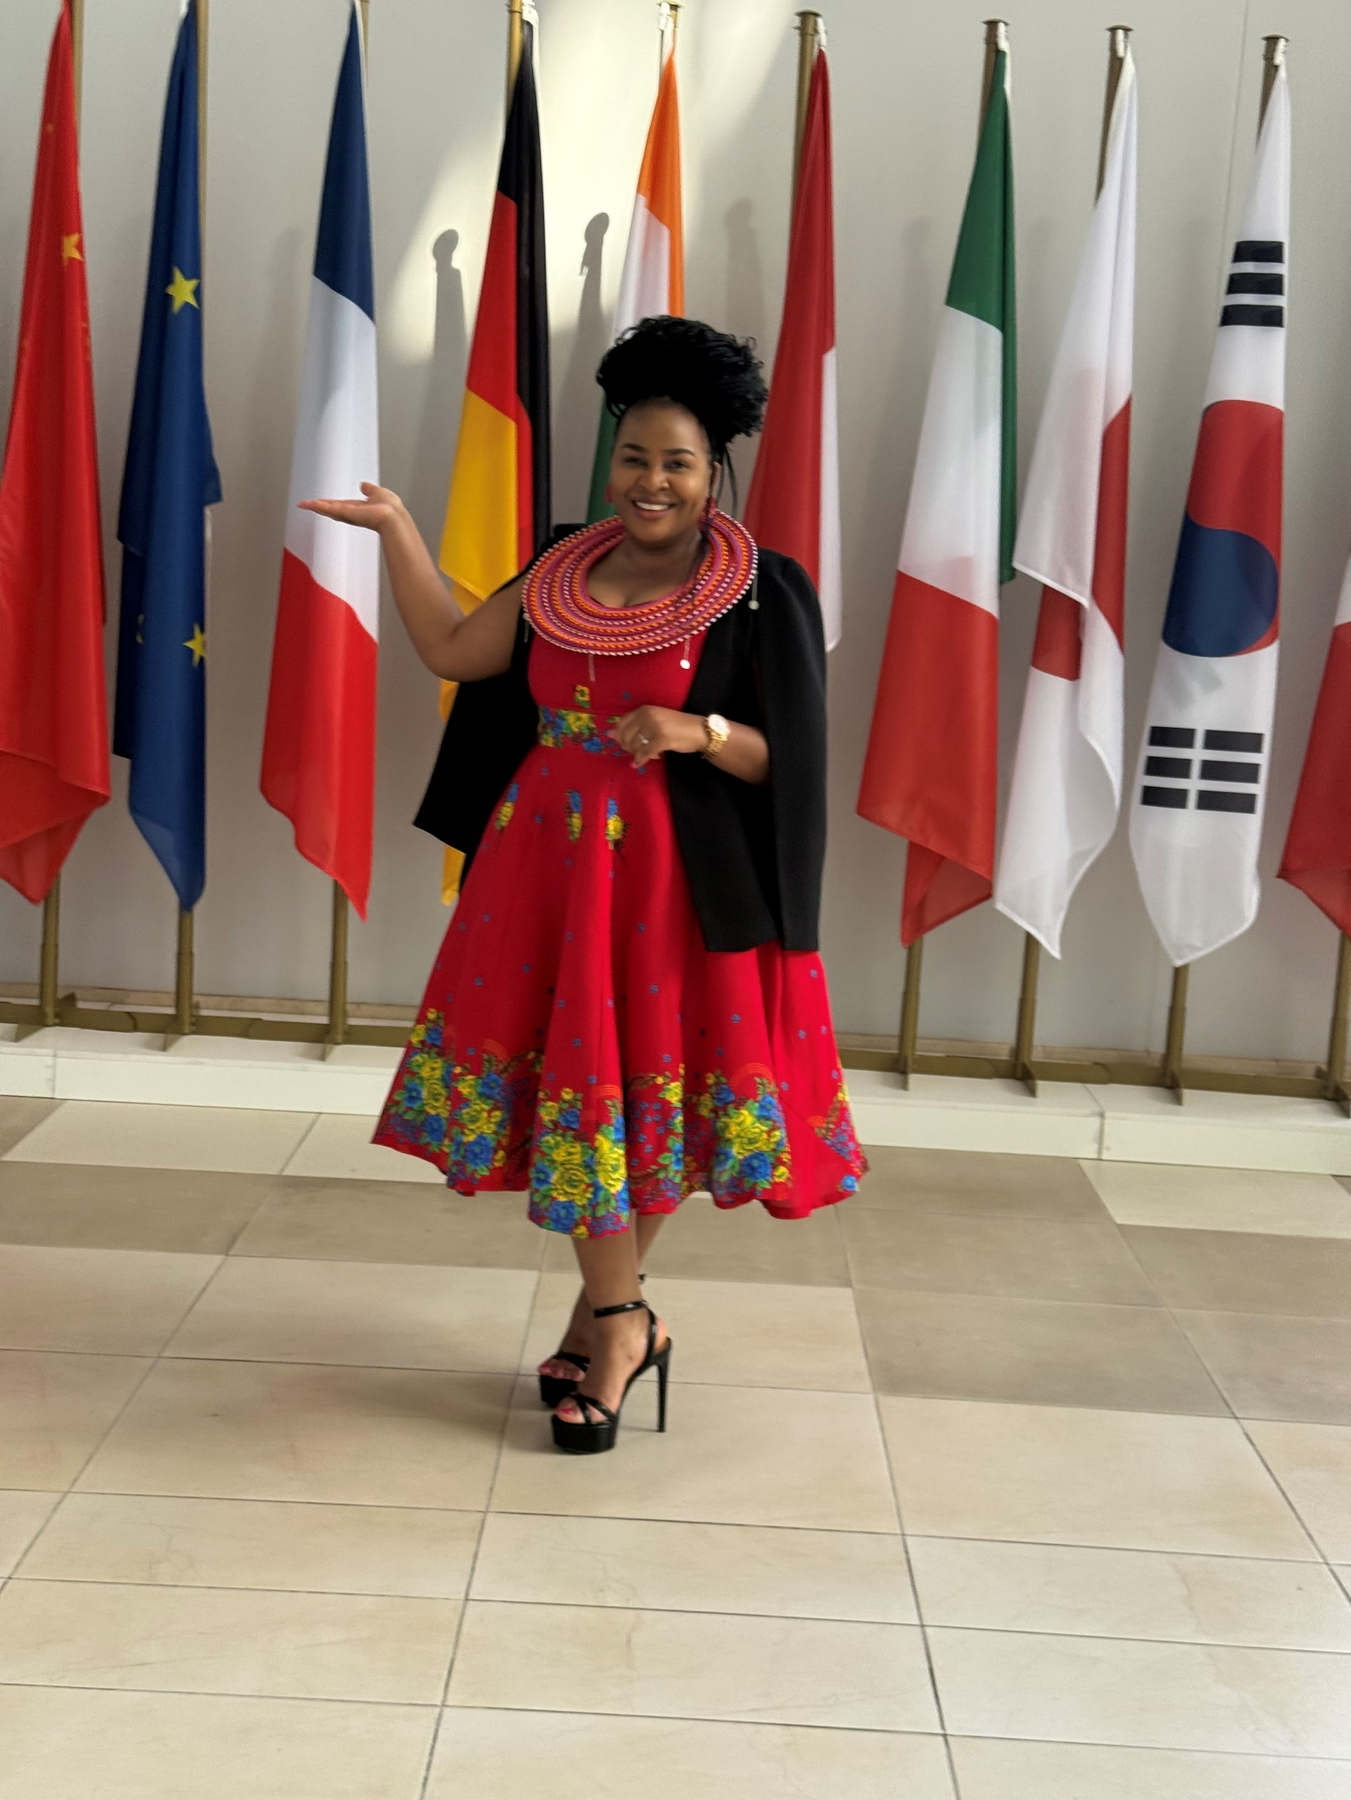

Finding My Voice
Before I could be heard, I had to hear myself first
I learned that a woman’s voice begins within.
I needed to hear, acknowledge, and embrace the voice inside me before others could listen.
I had to learn to listen to myself — to trust my instincts, my thoughts, and my convictions.
Before you can demand a seat at the table, you must be familiar with your own voice.
We cannot expect others to value a voice we ourselves have not learned to recognise.
Equipping my voice with strength and reason
To be heard, I also had to become a voice of reason.
I needed to equip myself with knowledge, learn new things, and unlearn old habits that would not take me where I am destined.
I had to prepare myself for the next step in leadership and influence.
A voice carries weight when it is informed, prepared, and grounded in values.

Slide 6
Watering her voice so she can have results!
Expose her to light
Water her with belief
surround yourself with mentors, allies, and positive influences.
Remind yourself daily that your voice matters..
Let her roots run deep
anchor in values, integrity, and purpose.
Feed her with knowledge
Continuous learning equips you to stand firm..
Grow into your own calling
Embrace the unique leader you are meant to be..
Prune old habits
unlearn patterns and mindsets that limit your growth..
Bear fruit that feeds others
Leadership is not only about your growth, but also about growing others.

Slide 7

Way forward….
“Societal norms may slow us down, but they cannot define our destination. When we know ourselves, prepare intentionally, and lead with courage, we rise above the barriers — not just for ourselves, but for the generations that follow.”
Societal Norms and Barriers
Call to Action
Traditional expectations vs. professional aspirations
Norms that have limited women’s leadership pathways
The courage to redefine ourselves and inspire others
Building a collective movement for change
Believe in your voice and use it
Contribute with excellence to your SAI’s mandate
Support and mentor other women
Together, we shape stronger institutions and societies

Slide 8
Questions???????????????

